Slide 1
Canada’s Food Price Report: Forecast 2022
Ethan Jackson, Sara El-Shawa, Simon Somogyi, and Graham Taylor
October 29, 2021

Slide 2
2021 Forecast Review

Slide 3
2021 Forecast Review
CPI Categories | 2021 Canada’s Food Price Report Forecast | 2021 Actual Change in CPI (2021 Mean Rel. to 2020 Mean)
Bakery | 3.5% to 5.5% | -0.4
Dairy | 1% to 3% | +4.3
Fish & Seafood | 1.5% to 3.5% | +0.6
Food At Restaurant | 3% to 5% | +4.0
Food | 3% to 5% | +2.8
Fruit | 2% to 4% | +3.4
Meat | 4.5% to 6.5% | +4.9
Other | 2% to 4% | +3.4
Vegetables | 4.5% to 6.5% | -3.6

Slide 4
Experiment Design

Slide 5
Data Sources
Historical Canadian Food CPI Values from Statistics Canada
325 Additional Variables from FRED Economic Database, Including:
Canada / U.S. Foreign Exchange Rate (DEXCAUS)
Crude Oil Prices: West Texas Intermediate (WTI) - Cushing, Oklahoma (DCOILWTICO)
Wilshire 5000 Total Market Index (WILL5000IND)
CBOE S&P 100 Volatility Index: VXO (VXOCLS)
Consumer Price Index for All Urban Consumers: Meats, Poultry, Fish, and Eggs in U.S. City Average (CUSR0000SAF112)
Consumer Price Index for All Urban Consumers: Fruits and Vegetables in U.S. City Average (CUSR0000SAF113)
Consumer Price Index for All Urban Consumers: Food and Beverages in U.S. City Average (CPIFABSL)
Unemployment Rate (UNRATE)
Effective Federal Funds Rate (FEDFUNDS)
Long-Term Government Bond Yields: 10-year: Main (Including Benchmark) for Canada (IRLTLT01CAM156N)
Unemployment Rate: Aged 15 and Over: All Persons for Canada (LRUNTTTTCAM156S)
Consumer Price Index: Total, All Items for Canada (CPALCY01CAM661N)
Consumer Price Index: OECD Groups: All Items Non-Food and Non-Energy for Canada (CPGRLE01CAM657N)
Real Residential Property Prices for Canada (QCAR368BIS)

Slide 6
Data Summary
334 Variables
Historical CPI From Statistics Canada
325 Variables from the FRED Database
426 Months
January 1986 to September 2021
All Data Sampled Monthly

Slide 7
Approach
Consider multiple (new) forecasting methods over different sets of dependent variables.
Evaluate how well each method would have done if it had been used for the last six report years (2016 to 2021).
Use the best-performing method per food CPI category, on average, to produce this year’s forecast.

Slide 8
Algorithms
Facebook’s Prophet
Univariate, autoregressive extrapolation of trend and seasonality components.
NeuralProphet
Multivariate regression model inspired by Prophet. We consider two variables per model, e.g. historical vegetable prices & CAD/USD exchange rate.
N-BEATS
A single Deep Learning model trained to forecast many variables at once.

Slide 9
N-BEATS
N-BEATS
Neural Basis Expansion Analysis for Interpretable Time Series Forecasting
A single Deep Learning model trained to forecast many variables at once.
Like multi-task learning, from a machine learning perspective.
Learns a set of common basis functions that are useful for many univariate forecasting problems, simultaneously.
Patterns learned by studying one set of time series variable help the model to improve its predictions on other time series variables.
Notes:
One slide to explain that multivariate never really gave us great results. Multi task on the other hand can be quite effective. Multi task training allows model to learn associations between many time series simultansously, that do not need to satisfy any constraints around independence of variables. Why can’t you just use VAR for this?? Why not a fancy MLP version of that?

Slide 10
Experiments
Train and evaluate (cross-validate) the following methods:
prophet | Univariate, autoregressive model.
neuralprophet | Multivariate model with selected dependent variables.
nbeats | N-BEATS model trained using food CPI only.
nbeatsfredvars | N-BEATs model trained using food CPI and FRED variables.

Slide 11
Experiments
Train and evaluate (cross-validate) the following methods:
prophet | Univariate, autoregressive model.
neuralprophet | Multivariate model with selected dependent variables.
nbeats | N-BEATS model trained using food CPI only.
nbeatsfredvars | N-BEATs model trained using food CPI and FRED variables.
Experiment Outline
For Each Food CPI Category:
Fit multiple forecasting models using data up to cutoff date (e.g. July 2015)
Use each of these models to simulate the 2016 Forecast.
Find the combination of models that produced the most accurate forecast.
Repeat steps 1 to 3 for each report year from 2017 to 2021.

Slide 12
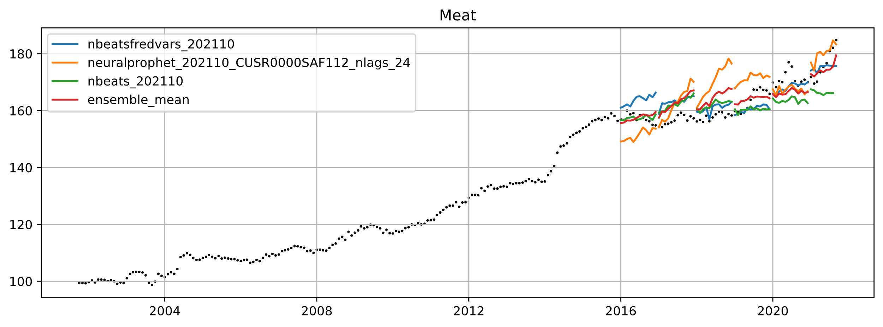
Experiment: Meat CPI
CUSR0000SAF112
Consumer Price Index for All Urban Consumers: Meats, Poultry, Fish, and Eggs in U.S. City Average
Yearly Simulated Forecasts
 | Statistics Over Last 6 Simulated Report Years
Model Configuration | Average MAPE | Average Std. Dev.
('neuralprophet_202110_CUSR0000SAF112_nlags_24',) | 4.10% | 1.80%
('nbeatsfredvars_202110',) | 2.70% | 1.00%
('nbeats_202110',) | 3.20% | 1.40%
('nbeatsfredvars_202110', 'neuralprophet_202110_CUSR0000SAF112_nlags_24', 'nbeats_202110') | 2.60% | 1.10%
Best model among those considered, on average, if it had been used for the last 6 reports.

Slide 13
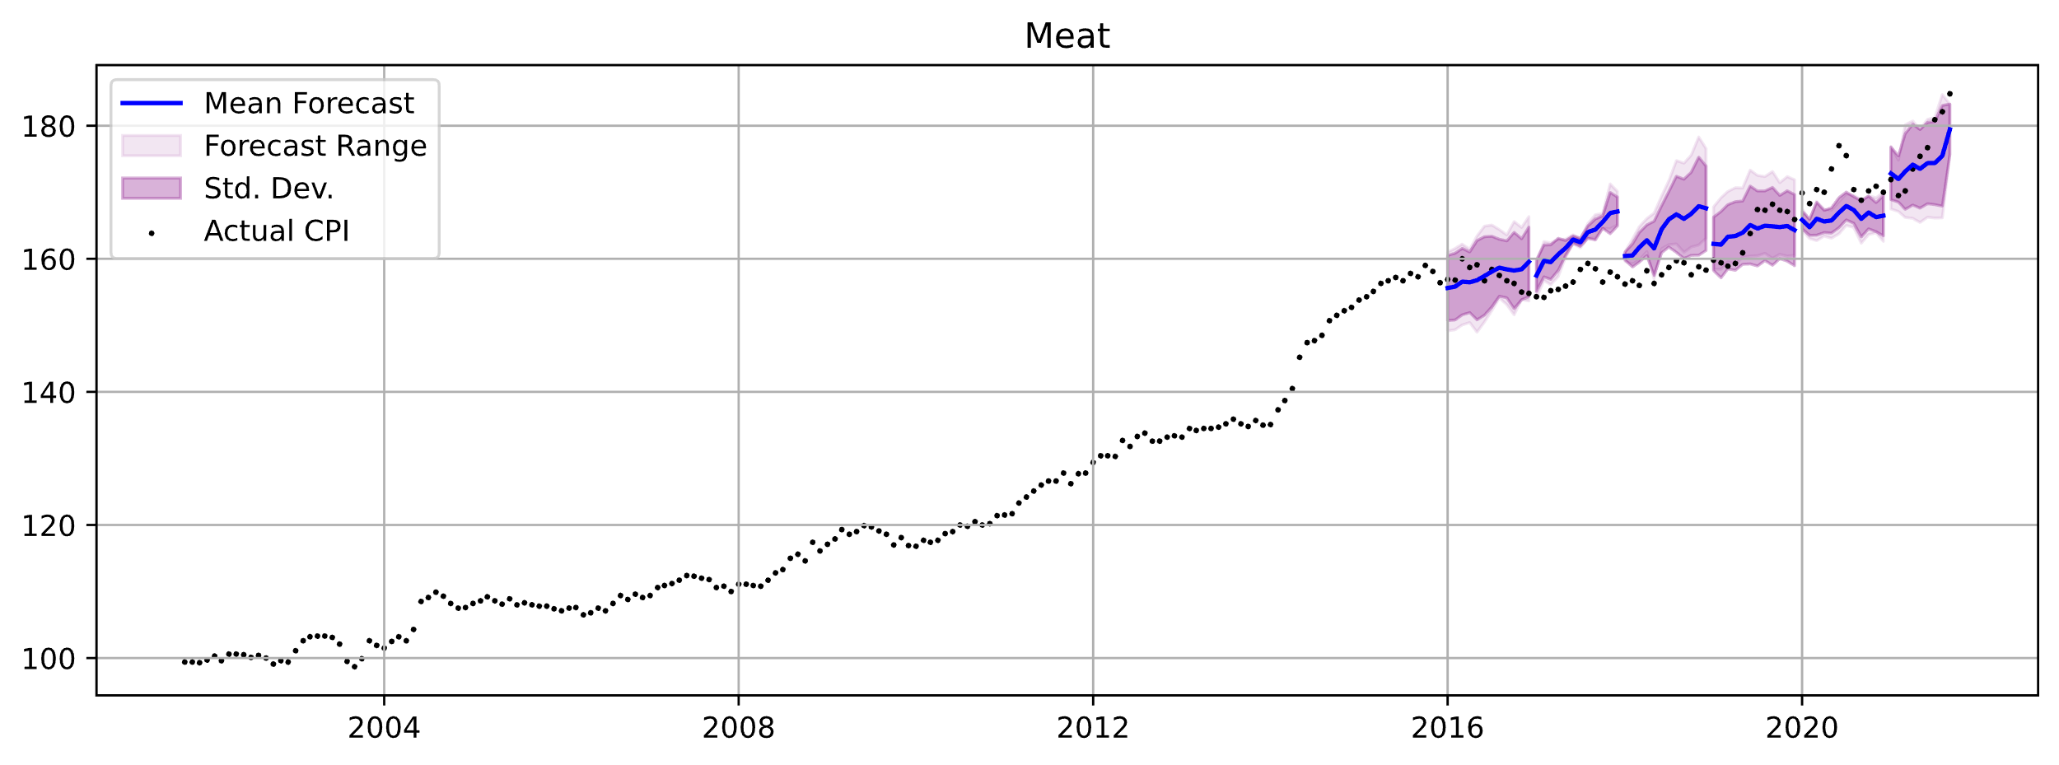
Experiment: Meat CPI
CUSR0000SAF112
Consumer Price Index for All Urban Consumers: Meats, Poultry, Fish, and Eggs in U.S. City Average
 | Statistics Over Last 6 Simulated Report Years
Model Configuration | Average MAPE | Average Std. Dev.
('nbeatsfredvars_202110', 'neuralprophet_202110_CUSR0000SAF112_nlags_24', 'nbeats_202110') | 2.60% | 1.10%

Slide 14
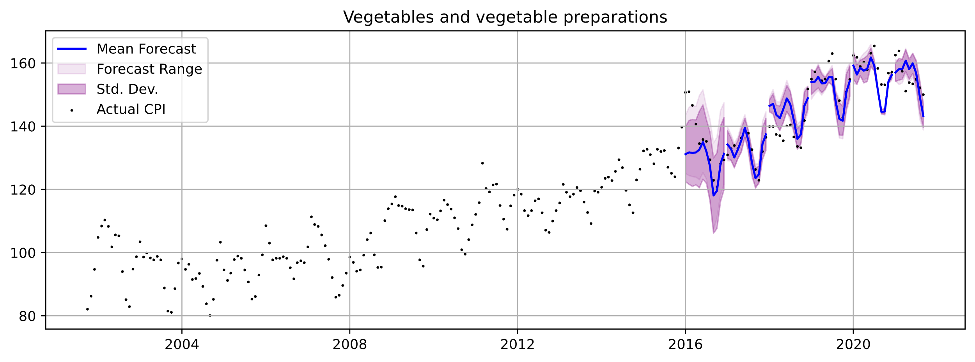
Experiment: Vegetables CPI
DEXCAUS
Canada / U.S. Foreign Exchange Rate
WILL5000IND
Wilshire 5000 Total Market Index
CPGRLE01CAM657N
Consumer Price Index: OECD Groups: All Items Non-Food and Non-Energy for Canada
 | Statistics Over Last 6 Simulated Report Years
Model Configuration | Average MAPE | Average Std. Dev.
('neuralprophet_202110_DEXCAUS_nlags_24', 'neuralprophet_202110_WILL5000IND_nlags_60', 'neuralprophet_202110_CPGRLE01CAM657N_nlags_60') | 2.90% | 1.20%

Slide 15
2022 Forecasts

Slide 16
Summary
CPI Categories | 2022 Forecast (Predicted 2022 Mean CPI Rel. to Mean 2021 CPI) | 2022 Forecast (Predicted Year-Over-Year Percent Change)
Bakery | +1.2 Points | +0.8%
Dairy | +3 Points | +2.1%
Fish & Seafood | +5.5 Points | +3.8%
Food At Restaurant | +8.6 Points | +5.2%
Food | +2.2 Points | +1.4%
Fruit | +5.1 Points | +3.6%
Meat | +8.6 Points | +4.9%
Other | +1.8 Points | +1.3%
Vegetables | +14.5 Points | +9.3 %

Slide 17
Expanded Results
Predicted Absolute Change in Food CPI Relative to 2021 Mean CPI, So Far
Predicted Absolute Change in Food CPI Relative to 2021 Max CPI, So Far
 | min | mean | max
Bakery | -3.9 | 1.2 | 9.1
Dairy and Eggs | -1.3 | 3 | 6.5
Fish and Seafood | 1.5 | 5.5 | 11.6
Food purchased from restaurants | 3.2 | 8.6 | 16.5
Food | -4.2 | 2.2 | 7.3
Fruit | -2.3 | 5.1 | 16.6
Meat | 4 | 8.6 | 13.8
Other | -1.7 | 1.8 | 7
Vegetables | -4.6 | 14.5 | 40.1
 | min | mean | max
Bakery | -5.2 | -0.1 | 7.7
Dairy and Eggs | -4 | 0.3 | 3.8
Fish and Seafood | -0.4 | 3.6 | 9.7
Food purchased from restaurants | 1.3 | 6.7 | 14.6
Food | -6.2 | 0.2 | 5.3
Fruit | -4.3 | 3.1 | 14.6
Meat | -4.7 | -0.1 | 5.1
Other | -4.7 | -1.1 | 4.1
Vegetables | -12.9 | 6.1 | 31.7

Slide 18
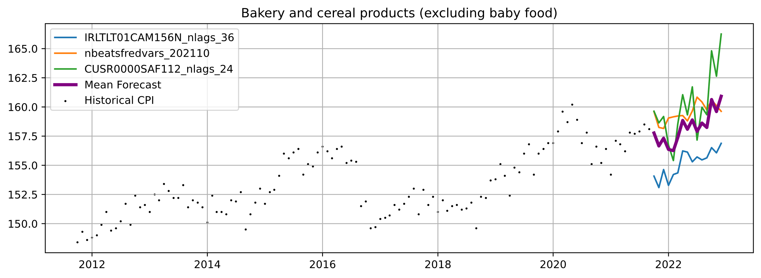
Bakery
 | Mean | Max
2021 Observed CPI | 157.1 | 158.5
2022 Expected CPI | 158.4 | 166.2
Change (Absolute Points) | +1.2 Points | +7.7 Points
Change (Percent Change) | +0.8% | +4.9%
CUSR0000SAF112
Consumer Price Index for All Urban Consumers: Meats, Poultry, Fish, and Eggs in U.S. City Average
IRLTLT01CAM156N
Long-Term Government Bond Yields: 10-year: Main (Including Benchmark) for Canada

Slide 19
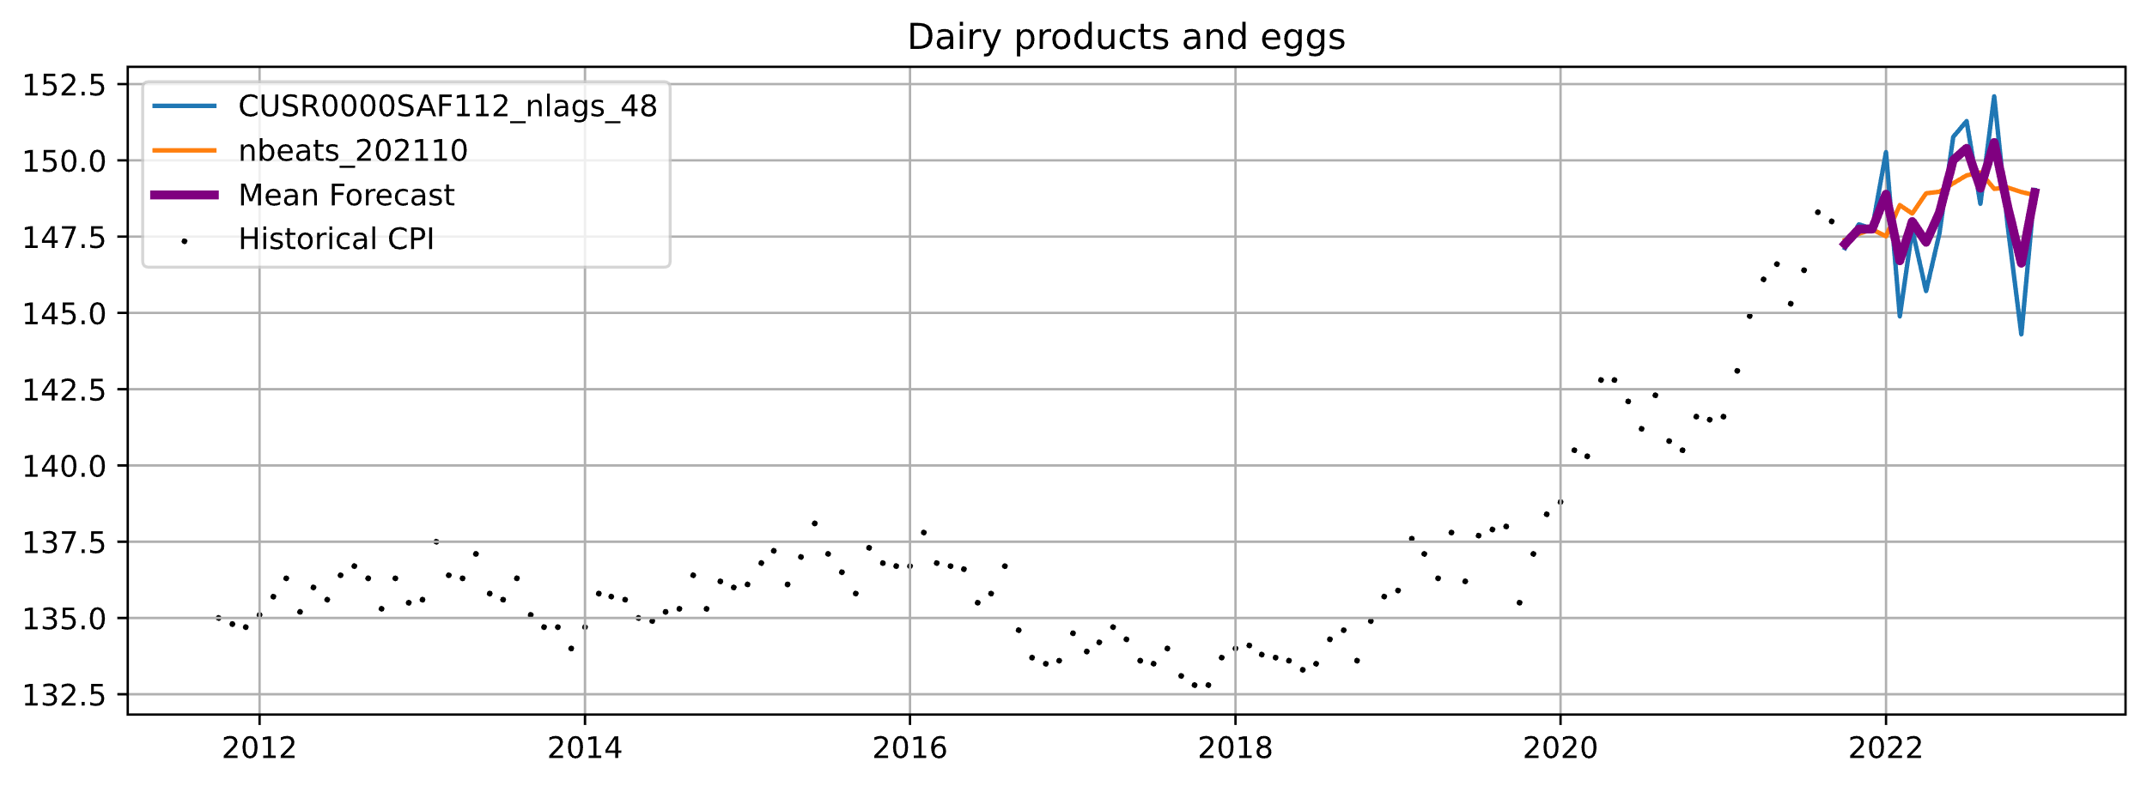
Dairy and Eggs
 | Mean | Max
2021 Observed CPI | 145.6 | 148.3
2022 Expected CPI | 148.6 | 152.1
Change (Absolute Points) | +3 Points | +3.8 Points
Change (Percent Change) | +2.1% | +2.6%
CUSR0000SAF112
Consumer Price Index for All Urban Consumers: Meats, Poultry, Fish, and Eggs in U.S. City Average

Slide 20
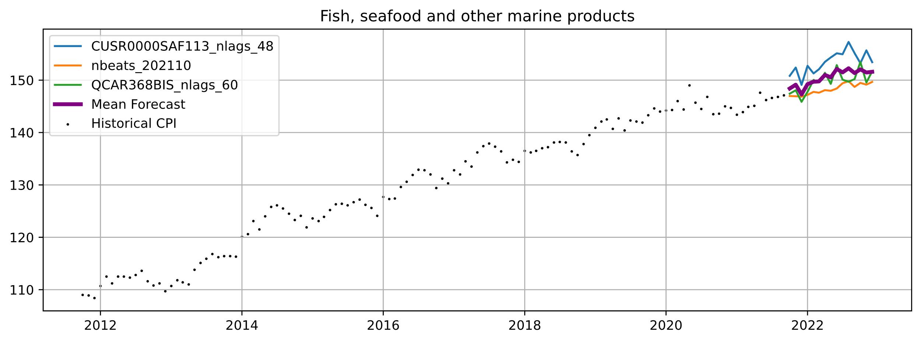
Fish and Seafood
 | Mean | Max
2021 Observed CPI | 145.7 | 147.6
2022 Expected CPI | 151.2 | 157.3
Change (Absolute Points) | +5.5 Points | +11.6 Points
Change (Percent Change) | +3.8% | +6.6%
CUSR0000SAF113
Consumer Price Index for All Urban Consumers: Fruits and Vegetables in U.S. City Average
QCAR368BIS
Real Residential Property Prices for Canada

Slide 21
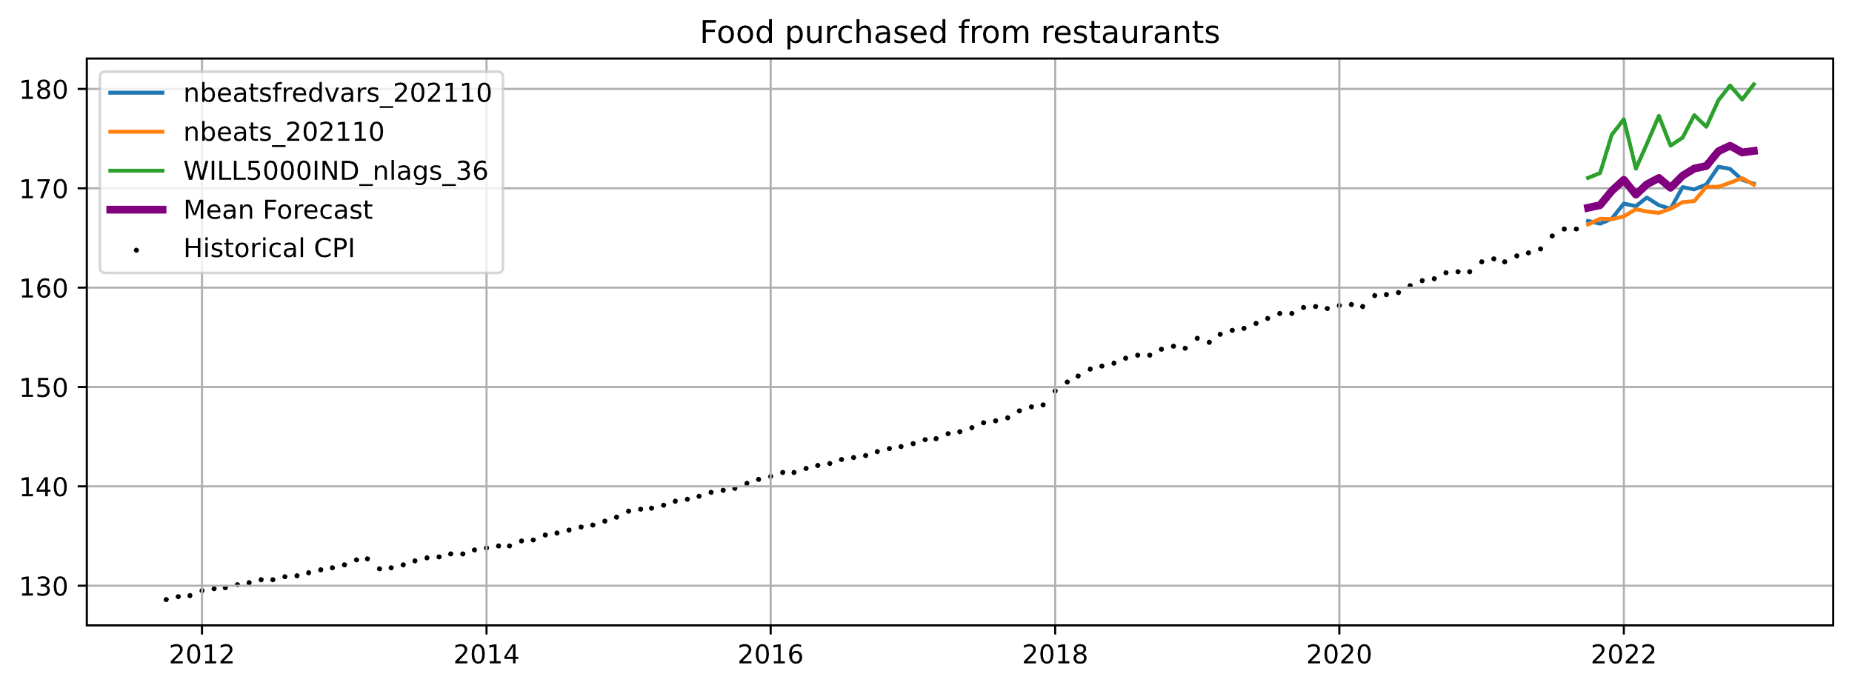
Food at Restaurant
 | Mean | Max
2021 Observed CPI | 164 | 165.9
2022 Expected CPI | 172.6 | 180.5
Change (Absolute Points) | +8.6 Points | +14.6 Points
Change (Percent Change) | +5.2% | +8.8%
WILL5000IND
Wilshire 5000 Total Market Index

Slide 22
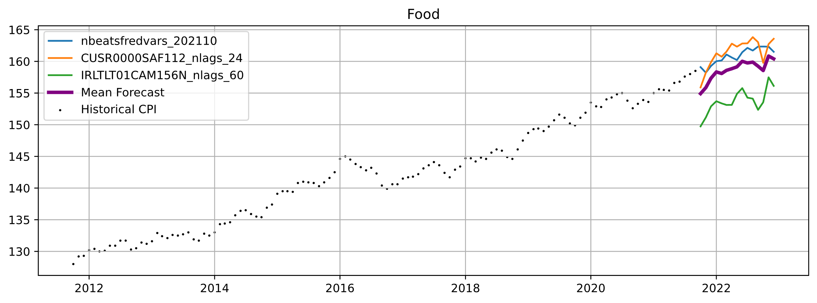
Food
 | Mean | Max
2021 Observed CPI | 156.6 | 158.5
2022 Expected CPI | 158.7 | 163.8
Change (Absolute Points) | +2.2 Points | +5.3 Points
Change (Percent Change) | +1.4% | +3.4%
CUSR0000SAF112
Consumer Price Index for All Urban Consumers: Meats, Poultry, Fish, and Eggs in U.S. City Average
IRLTLT01CAM156N
Long-Term Government Bond Yields: 10-year: Main (Including Benchmark) for Canada

Slide 23
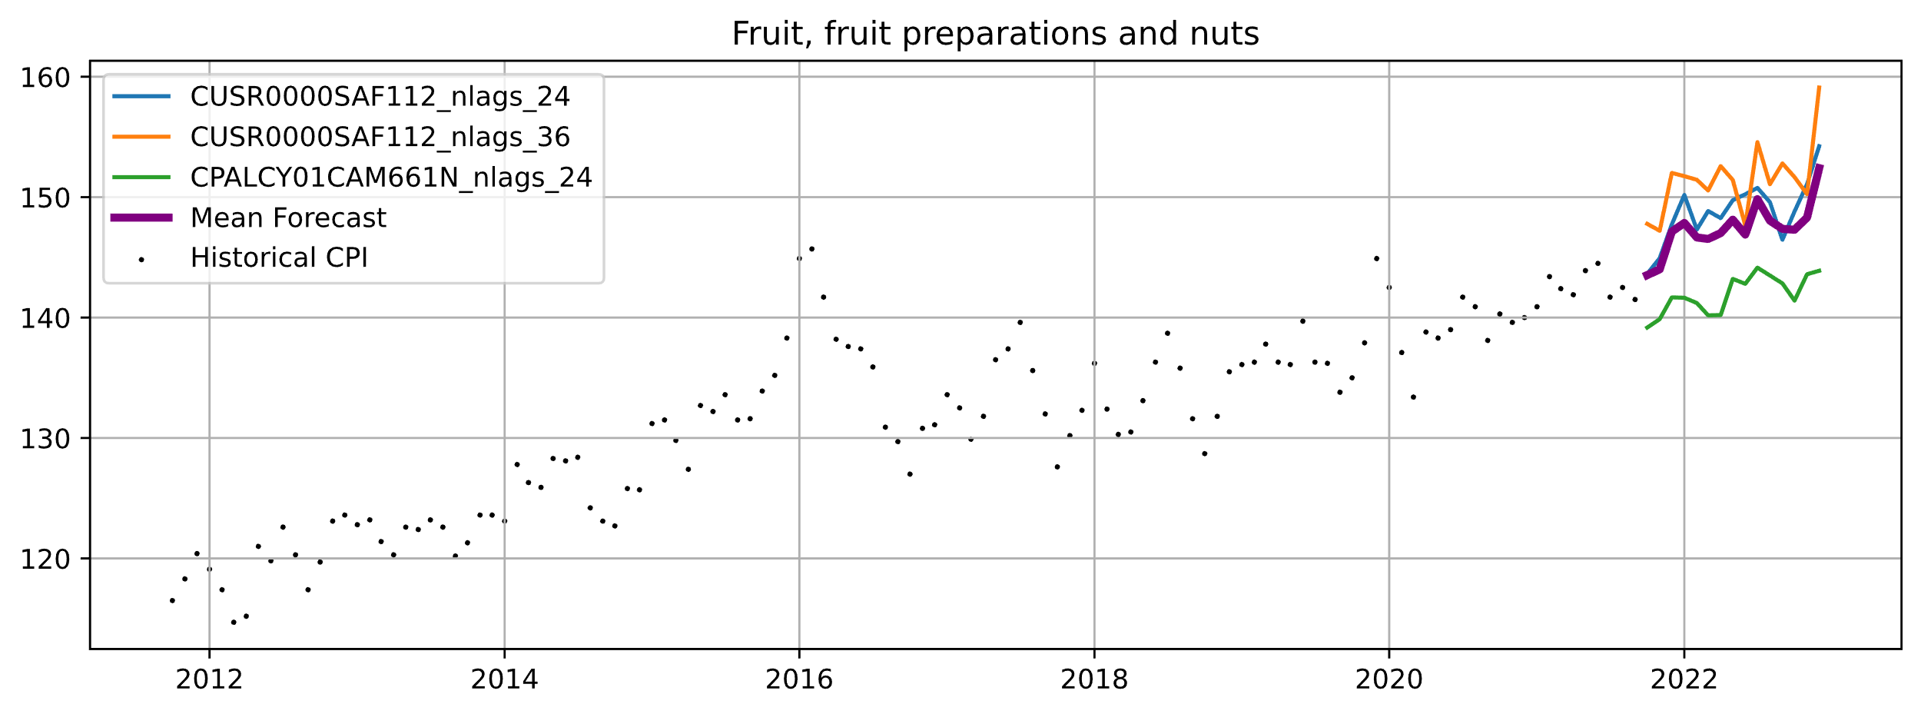
Fruit
 | Mean | Max
2021 Observed CPI | 142.5 | 144.5
2022 Expected CPI | 147.6 | 159.1
Change (Absolute Points) | +5.1 Points | +14.6 Points
Change (Percent Change) | +3.6% | +10.1%
CPALCY01CAM661N
Consumer Price Index: Total, All Items for Canada
CUSR0000SAF112
Consumer Price Index for All Urban Consumers: Meats, Poultry, Fish, and Eggs in U.S. City Average

Slide 24
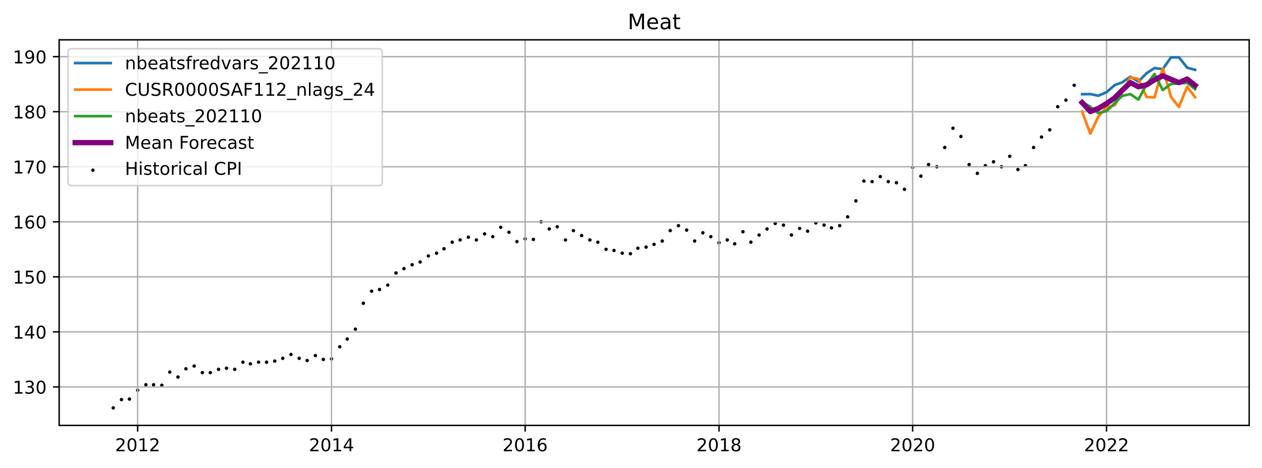
Meat
 | Mean | Max
2021 Observed CPI | 176.1 | 184.8
2022 Expected CPI | 184.7 | 189.9
Change (Absolute Points) | +8.6 Points | +5.1 Points
Change (Percent Change) | +4.9% | +2.7%
CUSR0000SAF112
Consumer Price Index for All Urban Consumers: Meats, Poultry, Fish, and Eggs in U.S. City Average

Slide 25
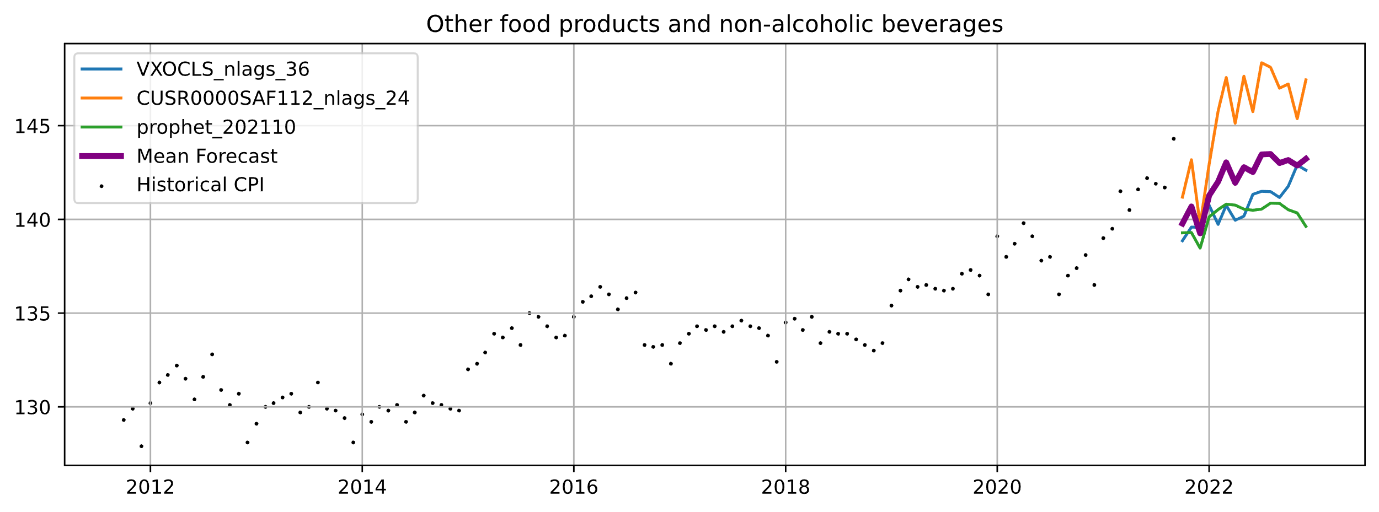
Other
 | Mean | Max
2021 Observed CPI | 141.4 | 144.3
2022 Expected CPI | 143.2 | 148.4
Change (Absolute Points) | +1.8 Points | +4.1 Points
Change (Percent Change) | +1.3% | +2.8%
CUSR0000SAF112
Consumer Price Index for All Urban Consumers: Meats, Poultry, Fish, and Eggs in U.S. City Average
VXOCLS
CBOE S&P 100 Volatility Index: VXO

Slide 26
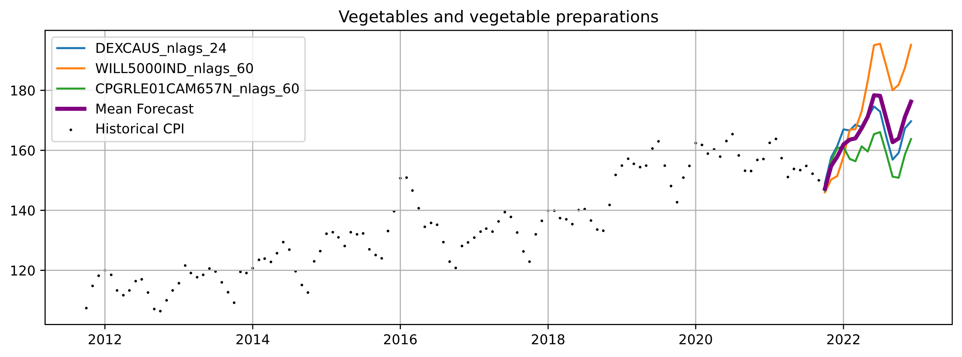
Vegetables
 | Mean | Max
2021 Observed CPI | 155.4 | 163.8
2022 Expected CPI | 169.9 | 195.5
Change (Absolute Points) | +14.5 Points | +31.7 Points
Change (Percent Change) | +9.3% | +19.4%
CPGRLE01CAM657N
Consumer Price Index: OECD Groups: All Items Non-Food and Non-Energy for Canada
DEXCAUS
Canada / U.S. Foreign Exchange Rate
WILL5000IND
Wilshire 5000 Total Market Index

Slide 27
Supplementary Material

Slide 28
Cross Validation Metrics (Best Models)
Mean and Standard Deviation of MAPE Over Last 6 Simulated Forecast Years
CPALCY01CAM661N
Consumer Price Index: Total, All Items for Canada
CUSR0000SAF112
Consumer Price Index for All Urban Consumers: Meats, Poultry, Fish, and Eggs in U.S. City Average
CUSR0000SAF113
Consumer Price Index for All Urban Consumers: Fruits and Vegetables in U.S. City Average
CPGRLE01CAM657N
Consumer Price Index: OECD Groups: All Items Non-Food and Non-Energy for Canada
DEXCAUS
Canada / U.S. Foreign Exchange Rate
IRLTLT01CAM156N
Long-Term Government Bond Yields: 10-year: Main (Including Benchmark) for Canada
QCAR368BIS
Real Residential Property Prices for Canada
VXOCLS
CBOE S&P 100 Volatility Index: VXO
WILL5000IND
Wilshire 5000 Total Market Index
Category | Best Ensemble | Average MAPE (± Std. Dev.)
Bakery and cereal products (excluding baby food) | ['neuralprophet_202110_IRLTLT01CAM156N_nlags_36', 'nbeatsfredvars_202110', 'neuralprophet_202110_CUSR0000SAF112_nlags_24'] | 1.40% (±0.88%)
Dairy products and eggs | ['neuralprophet_202110_CUSR0000SAF112_nlags_48', 'nbeats_202110'] | 1.55% (±0.53%)
Fish, seafood and other marine products | ['neuralprophet_202110_CUSR0000SAF113_nlags_48', 'nbeats_202110', 'neuralprophet_202110_QCAR368BIS_nlags_60'] | 1.09% (±0.20%)
Food purchased from restaurants | ['nbeatsfredvars_202110', 'nbeats_202110', 'neuralprophet_202110_WILL5000IND_nlags_36'] | 0.61% (±0.37%)
Food | ['nbeatsfredvars_202110', 'neuralprophet_202110_CUSR0000SAF112_nlags_24', 'neuralprophet_202110_IRLTLT01CAM156N_nlags_60'] | 0.76% (±0.26%)
Fruit, fruit preparations and nuts | ['neuralprophet_202110_CUSR0000SAF112_nlags_24', 'neuralprophet_202110_CUSR0000SAF112_nlags_36', 'neuralprophet_202110_CPALCY01CAM661N_nlags_24'] | 2.04% (±0.71%)
Meat | ['nbeatsfredvars_202110', 'neuralprophet_202110_CUSR0000SAF112_nlags_24', 'nbeats_202110'] | 2.62% (±1.10%)
Other food products and non-alcoholic beverages | ['neuralprophet_202110_VXOCLS_nlags_36', 'neuralprophet_202110_CUSR0000SAF112_nlags_24', 'prophet_202110'] | 0.86% (±0.39%)
Vegetables and vegetable preparations | ['neuralprophet_202110_DEXCAUS_nlags_24', 'neuralprophet_202110_WILL5000IND_nlags_60', 'neuralprophet_202110_CPGRLE01CAM657N_nlags_60'] | 2.94% (±1.16%)

Slide 29
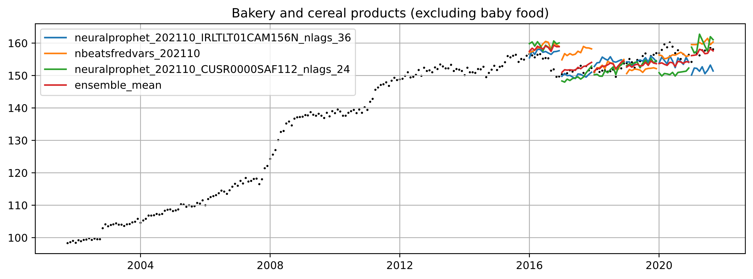
Bakery (Validation)
CUSR0000SAF112
Consumer Price Index for All Urban Consumers: Meats, Poultry, Fish, and Eggs in U.S. City Average
IRLTLT01CAM156N
Long-Term Government Bond Yields: 10-year: Main (Including Benchmark) for Canada
Category | Best Ensemble | Average MAPE (± Std. Dev.)
Bakery and cereal products (excluding baby food) | ['neuralprophet_202110_IRLTLT01CAM156N_nlags_36', 'nbeatsfredvars_202110', 'neuralprophet_202110_CUSR0000SAF112_nlags_24'] | 1.40% (±0.88%)

Slide 30
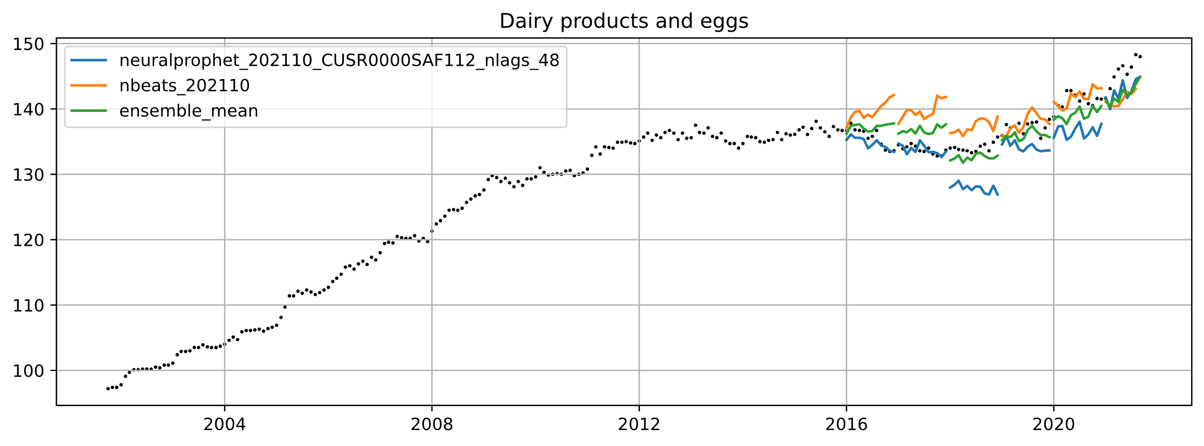
Dairy (Validation)
CUSR0000SAF112
Consumer Price Index for All Urban Consumers: Meats, Poultry, Fish, and Eggs in U.S. City Average
Category | Best Ensemble | Average MAPE (± Std. Dev.)
Dairy products and eggs | ['neuralprophet_202110_CUSR0000SAF112_nlags_48', 'nbeats_202110'] | 1.55% (±0.53%)

Slide 31
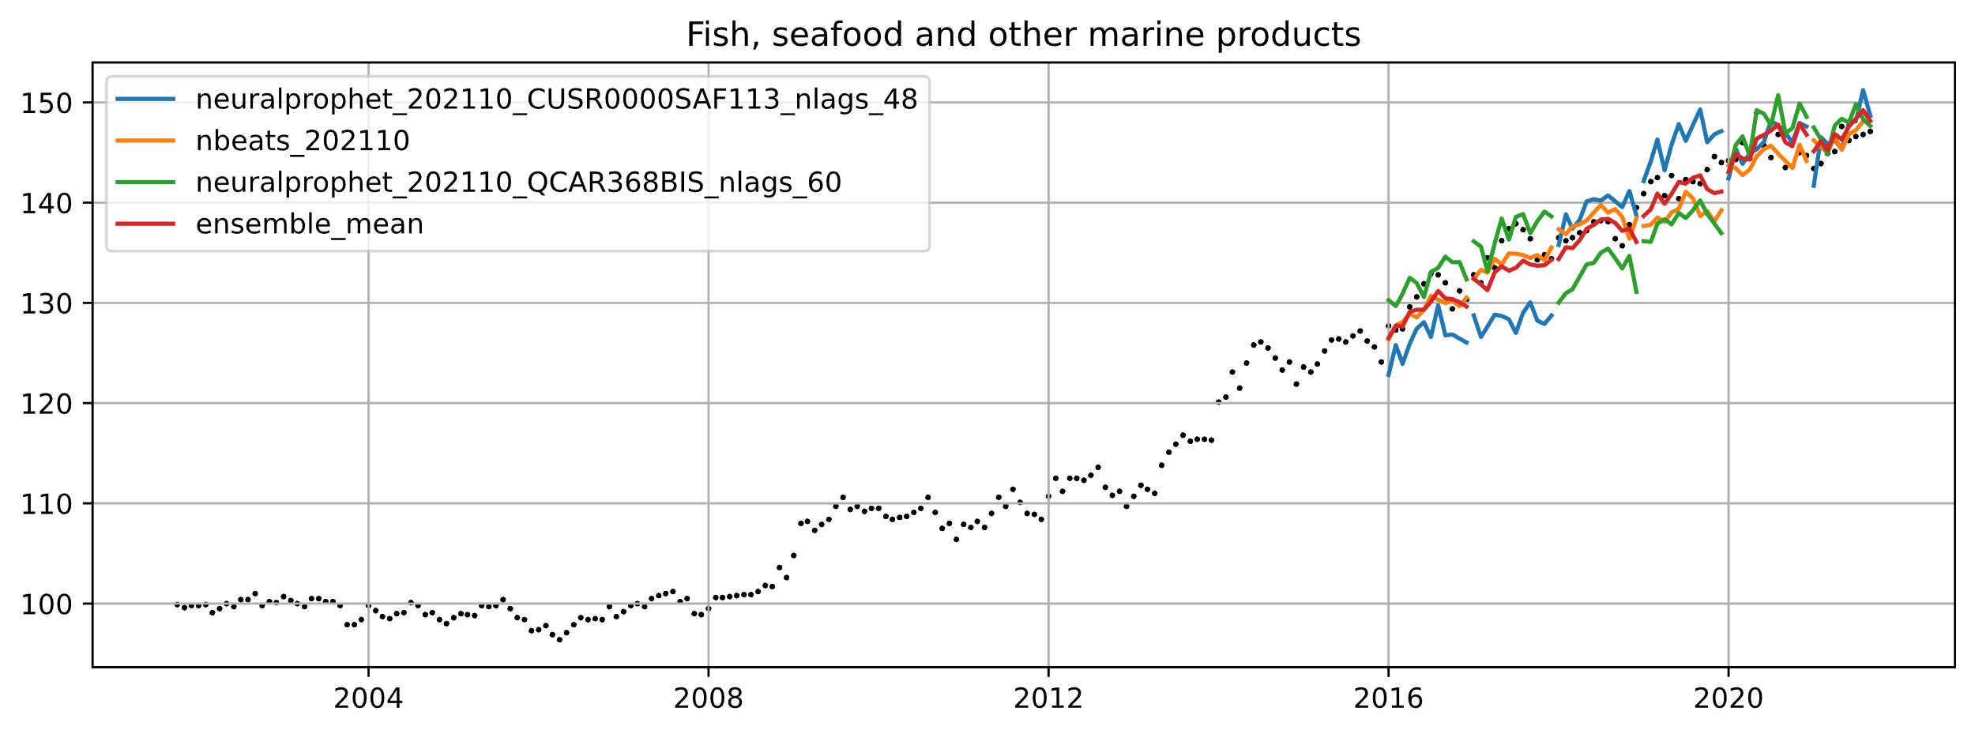
Fish and Seafood (Validation)
CUSR0000SAF113
Consumer Price Index for All Urban Consumers: Fruits and Vegetables in U.S. City Average
QCAR368BIS
Real Residential Property Prices for Canada
Category | Best Ensemble | Average MAPE (± Std. Dev.)
Fish, seafood and other marine products | ['neuralprophet_202110_CUSR0000SAF113_nlags_48', 'nbeats_202110', 'neuralprophet_202110_QCAR368BIS_nlags_60'] | 1.09% (±0.20%)

Slide 32
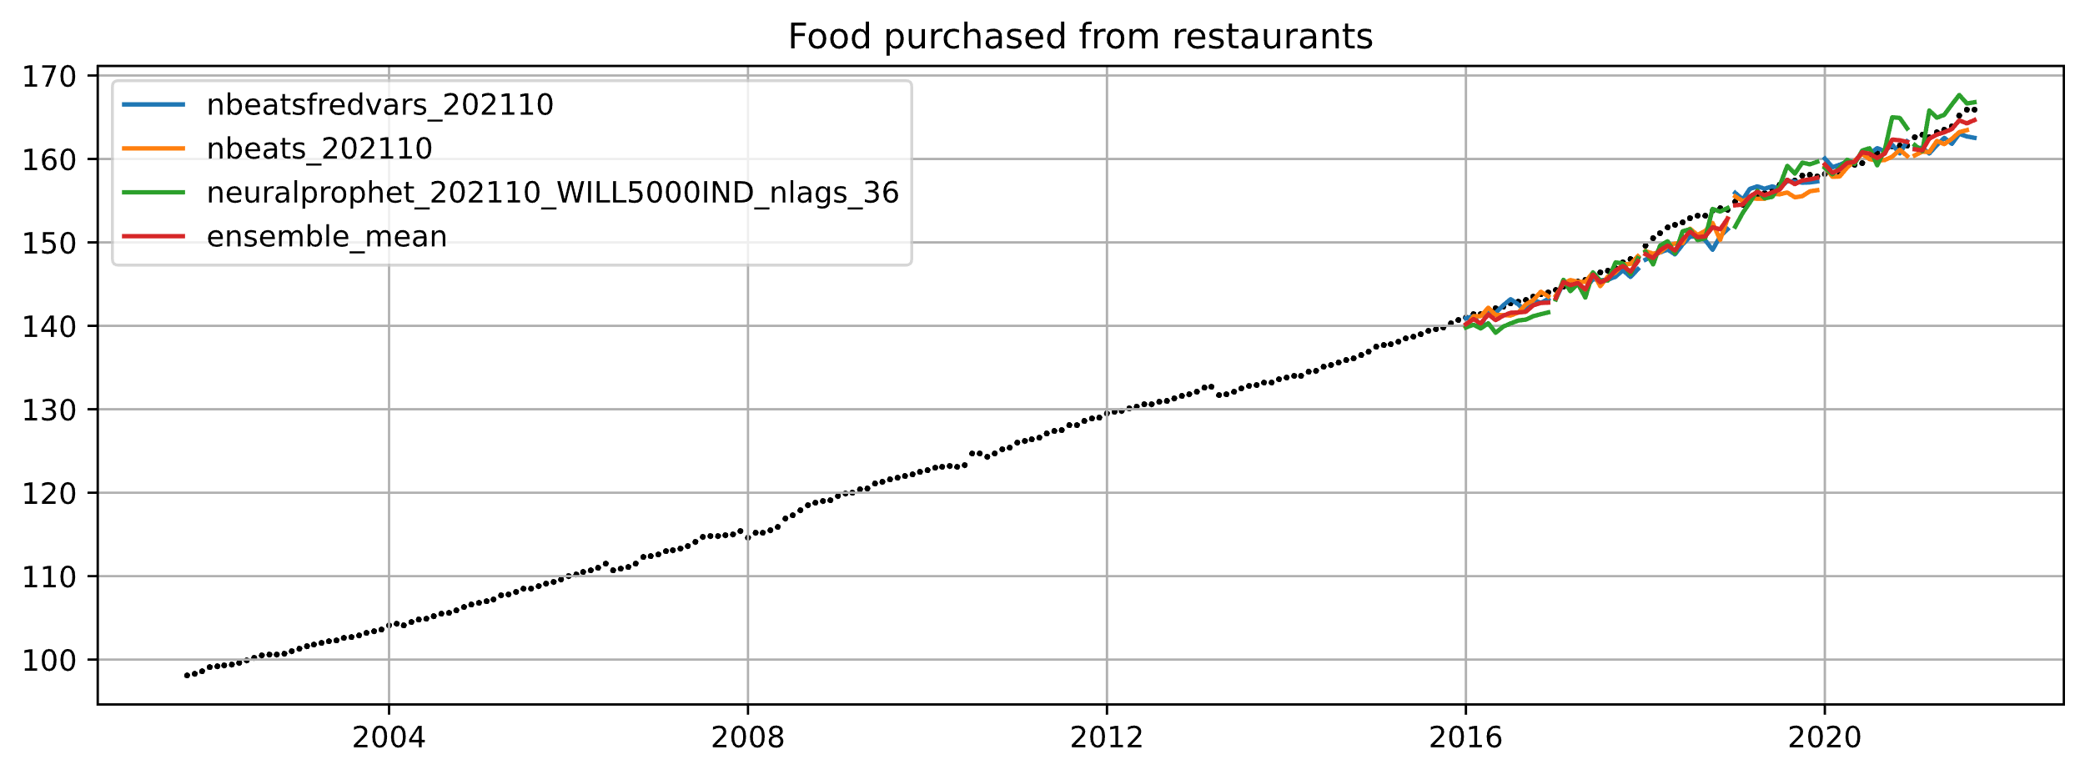
Restaurant (Validation)
WILL5000IND
Wilshire 5000 Total Market Index
Category | Best Ensemble | Average MAPE (± Std. Dev.)
Food purchased from restaurants | ['nbeatsfredvars_202110', 'nbeats_202110', 'neuralprophet_202110_WILL5000IND_nlags_36'] | 0.61% (±0.37%)

Slide 33
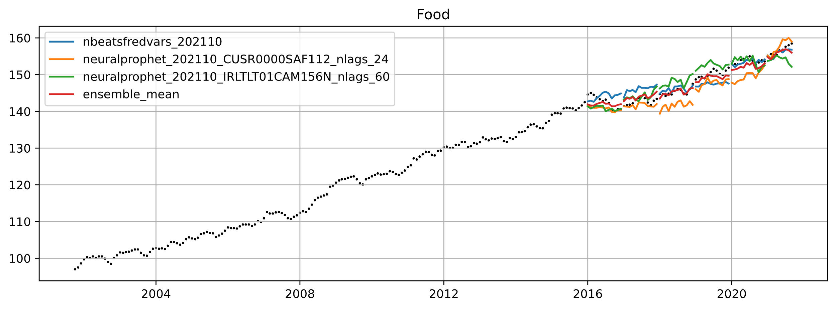
Food (Validation)
CUSR0000SAF112
Consumer Price Index for All Urban Consumers: Meats, Poultry, Fish, and Eggs in U.S. City Average
IRLTLT01CAM156N
Long-Term Government Bond Yields: 10-year: Main (Including Benchmark) for Canada
Category | Best Ensemble | Average MAPE (± Std. Dev.)
Food | ['nbeatsfredvars_202110', 'neuralprophet_202110_CUSR0000SAF112_nlags_24', 'neuralprophet_202110_IRLTLT01CAM156N_nlags_60'] | 0.76% (±0.26%)

Slide 34
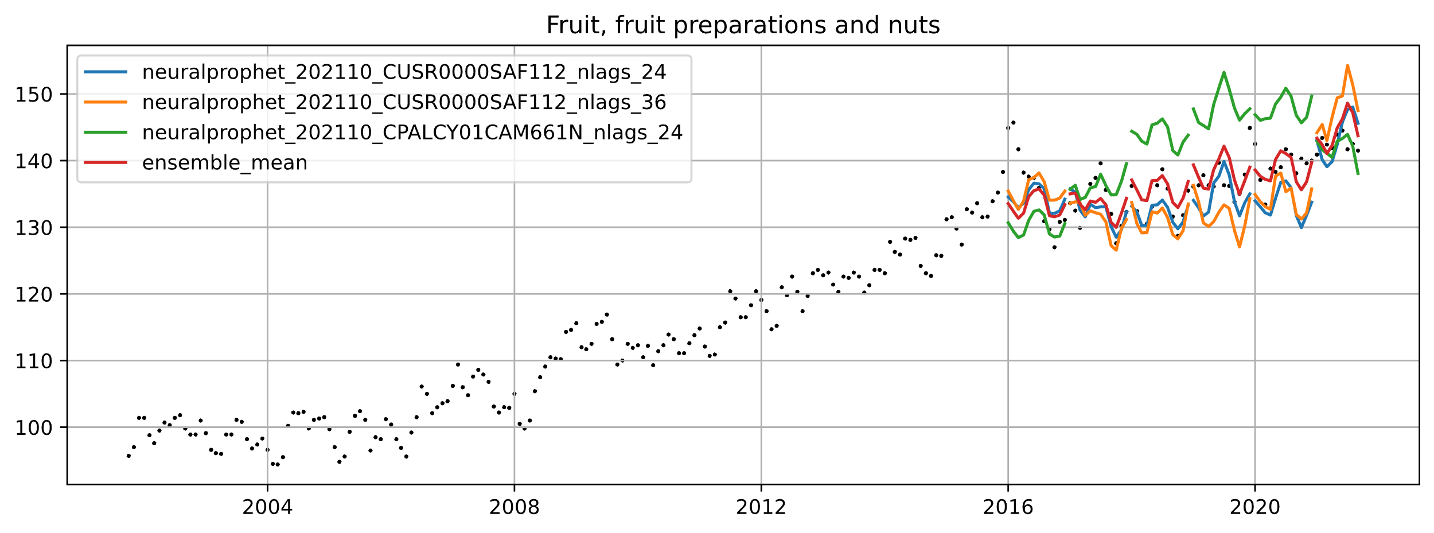
Fruit (Validation)
CPALCY01CAM661N
Consumer Price Index: Total, All Items for Canada
CUSR0000SAF112
Consumer Price Index for All Urban Consumers: Meats, Poultry, Fish, and Eggs in U.S. City Average
Category | Best Ensemble | Average MAPE (± Std. Dev.)
Fruit, fruit preparations and nuts | ['neuralprophet_202110_CUSR0000SAF112_nlags_24', 'neuralprophet_202110_CUSR0000SAF112_nlags_36', 'neuralprophet_202110_CPALCY01CAM661N_nlags_24'] | 2.04% (±0.71%)

Slide 35
Meat (Validation)
CUSR0000SAF112
Consumer Price Index for All Urban Consumers: Meats, Poultry, Fish, and Eggs in U.S. City Average
Category | Best Ensemble | Average MAPE (± Std. Dev.)
Meat | ['nbeatsfredvars_202110', 'neuralprophet_202110_CUSR0000SAF112_nlags_24', 'nbeats_202110'] | 2.62% (±1.10%)

Slide 36
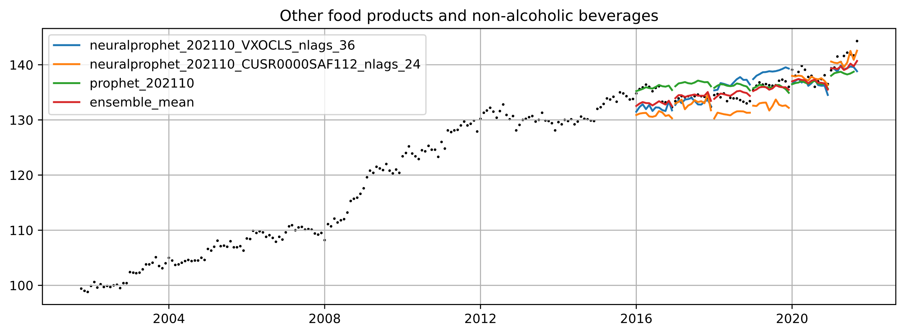
Other (Validation)
CUSR0000SAF112
Consumer Price Index for All Urban Consumers: Meats, Poultry, Fish, and Eggs in U.S. City Average
VXOCLS
CBOE S&P 100 Volatility Index: VXO
Category | Best Ensemble | Average MAPE (± Std. Dev.)
Other food products and non-alcoholic beverages | ['neuralprophet_202110_VXOCLS_nlags_36', 'neuralprophet_202110_CUSR0000SAF112_nlags_24', 'prophet_202110'] | 0.86% (±0.39%)

Slide 37
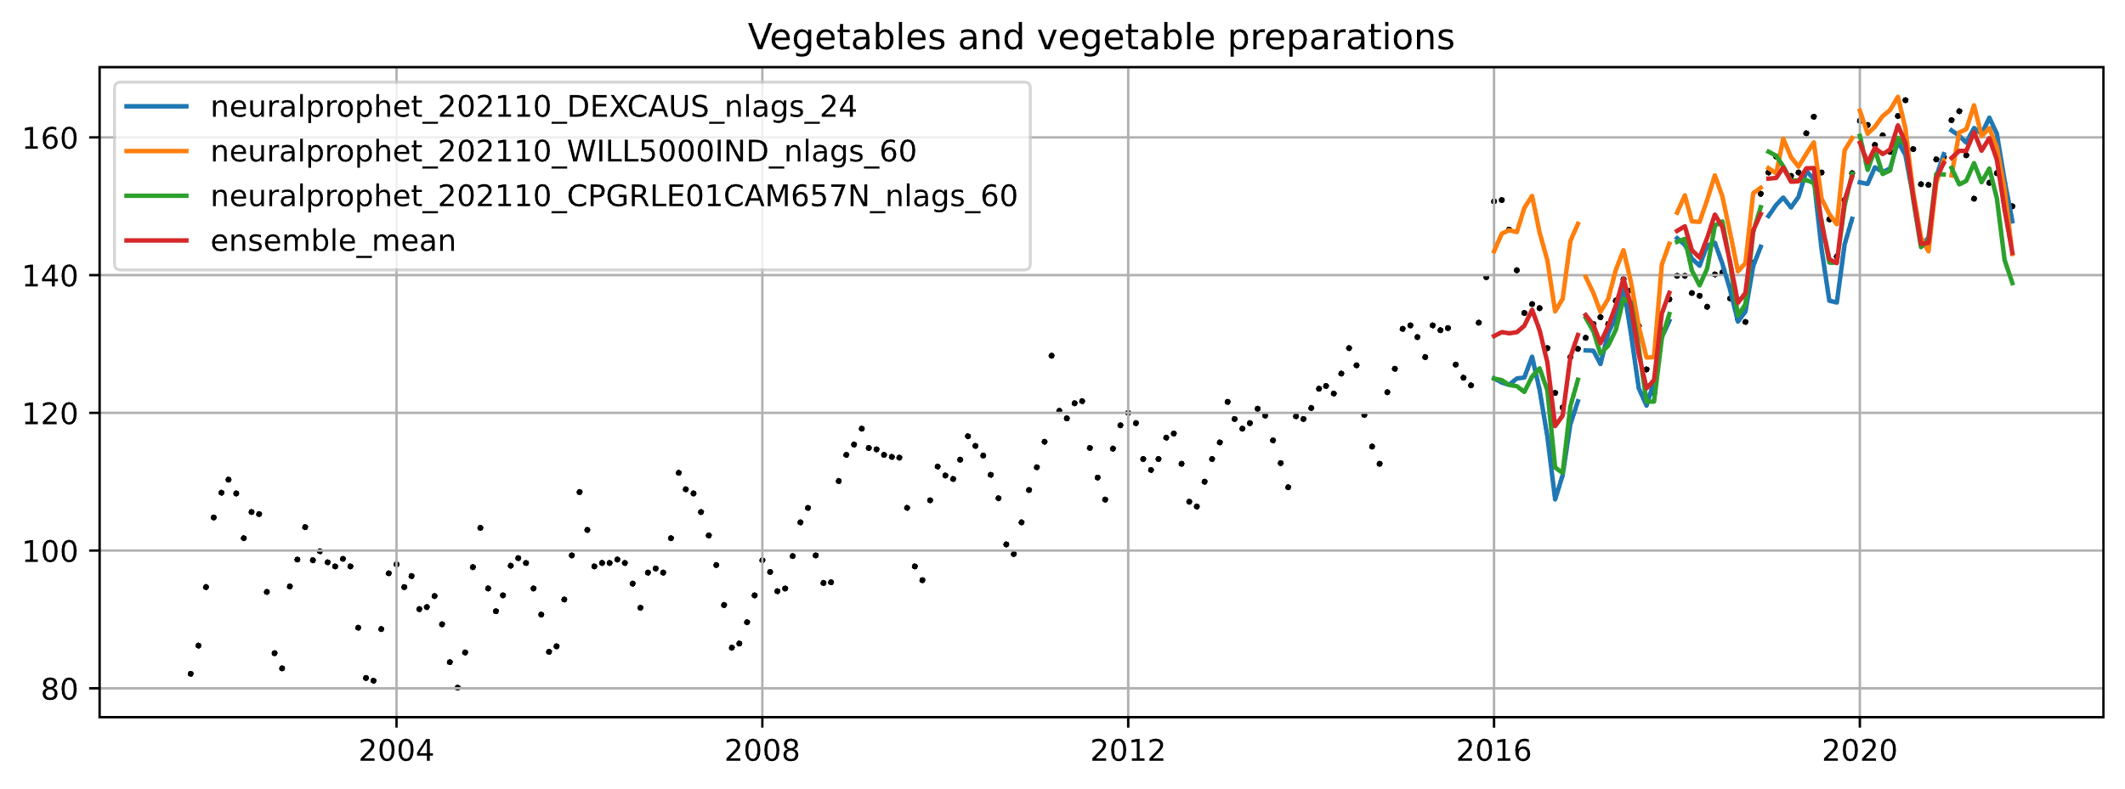
Vegetables (Validation)
CPGRLE01CAM657N
Consumer Price Index: OECD Groups: All Items Non-Food and Non-Energy for Canada
DEXCAUS
Canada / U.S. Foreign Exchange Rate
WILL5000IND
Wilshire 5000 Total Market Index
Category | Best Ensemble | Average MAPE (± Std. Dev.)
Vegetables and vegetable preparations | ['neuralprophet_202110_DEXCAUS_nlags_24', 'neuralprophet_202110_WILL5000IND_nlags_60', 'neuralprophet_202110_CPGRLE01CAM657N_nlags_60'] | 2.94% (±1.16%)

